Slide 1
SENTIMENT ANALYSIS OF TWITTER DATA AND REDDIT DATA
NAME : JEEVA K
DATE : 06/08/2021

Slide 2
OVERVIEW
This script performs EDA and then preprocesses the twitter.csv dataset and Reddit.csv to train a bidirectional LSTM model which is in turn used to predict the sentiments behind tweets fetched in real time using tweepy and classify them as positive negative or neutral.

Slide 3
DATA EXPLORATION
Data exploration is a key aspect of data analysis and model building. Without spending significant time on understanding the data and its patterns one cannot expect to build efficient predictive models. Data exploration takes major chunk of time in a data science project comprising of data cleaning and preprocessing

Slide 4
DATA PREPROCESSING TECHNIQUES
Missing values
Data Cleaning
Extract Features
Feature Encoding
Label Encoding
Handle Outliers
Separate Independent and dependent Features
then Select best Feature

Slide 5
DATA VISUALIZATION
Data visualization is the graphical representation of data in order to explore and visualize data to uncover insights from the start or identify areas or patterns to dig into more.
Using interactive dashboards and point-and-click data exploration, users can better understand the bigger picture and get to insights faster.

Slide 6
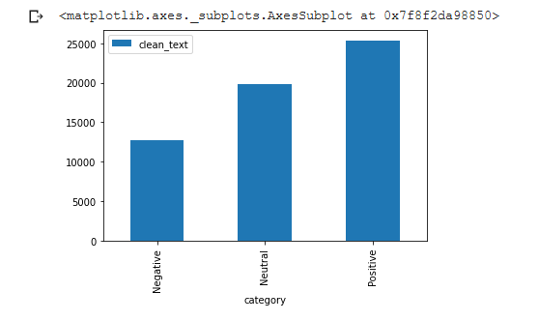
THREE CATEGORIES OF ANALYSIS

Slide 7
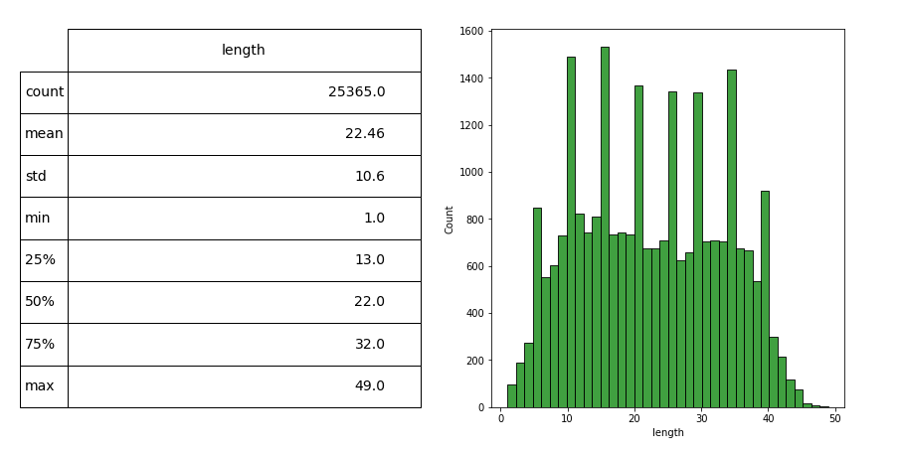
DISTRIBUTION OF TEXT LENGTH FOR POSITIVE SENTIMENT TWEETS

Slide 8
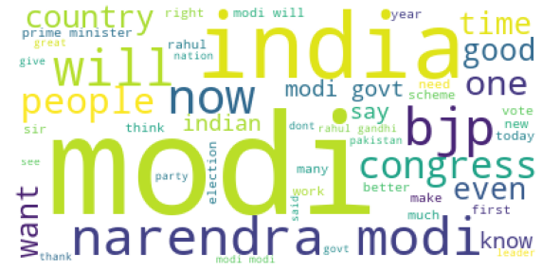
POSITIVE SENTIMENT WORDS

Slide 9
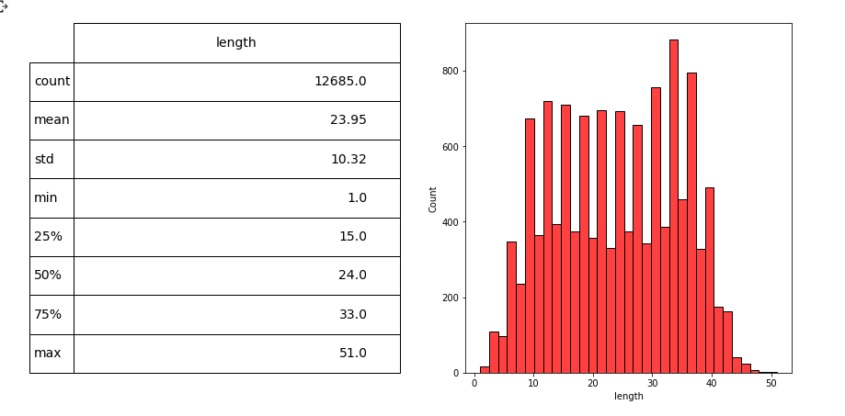
DISTRIBUTION OF TEXT LENGTH FOR NEGATIVE SENTIMENT TWEETS

Slide 10
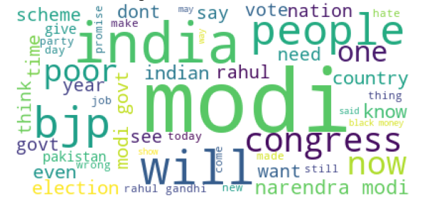
NEGATIVE SENTIMENT WORDS

Slide 11
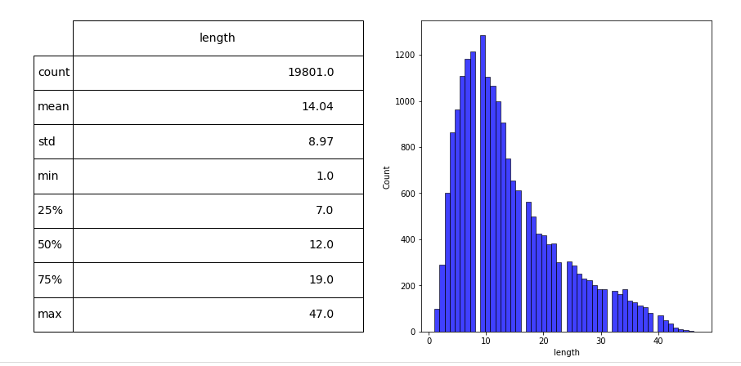
DISTRIBUTION OF TEXT LENGTH FOR NEUTRAL SENTIMENT TWEETS

Slide 12
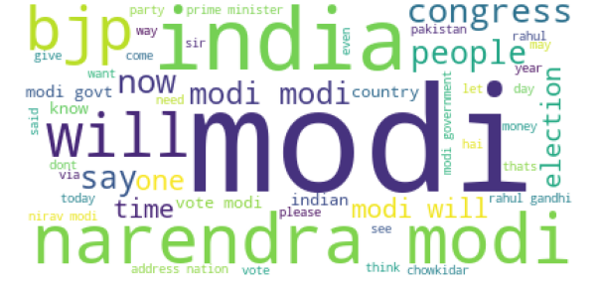
NEUTRAL SENTIMENT WORDS

Slide 13
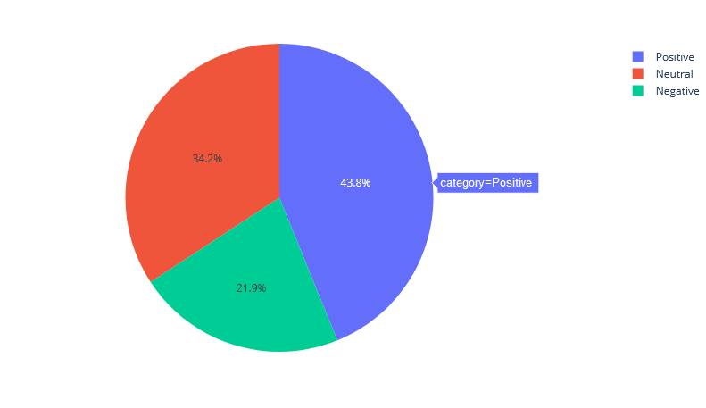
DIFFERENT SENTIMENTS OF TWEETS

Slide 14
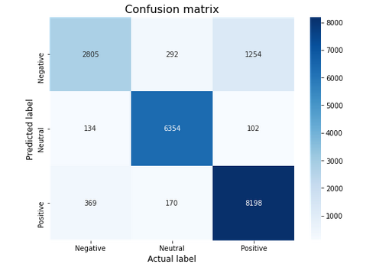
MODEL CONFUSION MATRIX

Slide 15
Thank You

